Slide 1
Document to Speech Conversion
Ruchi Manikrao Dhore
Kunal Dilip Mansukhani
Sanfer Samson Noronha
Stuti Sanjay Jani

Slide 2



Motivation & Problem Statement
A variety of learning resources are in written format
People with sight problems, disabilities, language barriers
Prefer listening to audio rather than reading the text
Text to speech solution widens the audience for textual data
The solution also needs a multi-lingual output

Slide 3
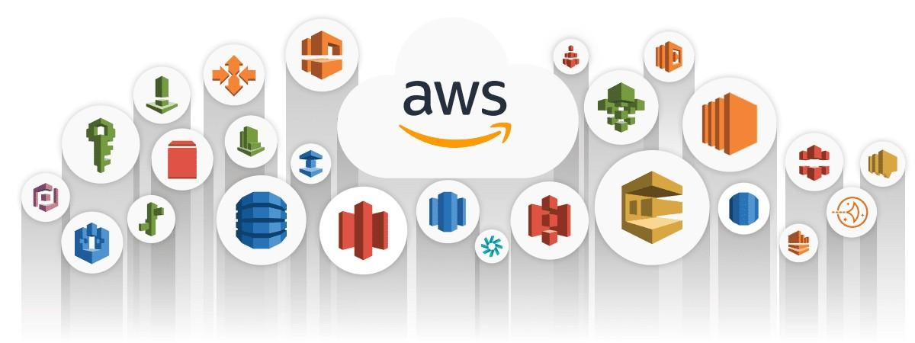
AWS
Amazon Web Services (AWS) is a cloud computing platform that includes infrastructure as a service (IaaS) and platform as a service (PaaS) components
AWS is used to compute, store, create databases and perform analytics
Advantages:
- Flexible
- Cost-Effective
- Scalable

Slide 4


Identity and Access Management (IAM)
Simple Storage Service (S3)
A web service that helps to control access to AWS resources
To control who is authenticated (signed in) and authorized (has permissions) to use resources
Grant different permissions to different users for different resources
Provides storage for the AWS cloud
Store any file type as an object, including images, documents, and videos

Slide 5


Lambda
DynamoDB
A serverless compute service used to run code without managing servers
Runs your code in response to events like change in state or an update, such as a user placing an item in a shopping cart
Lets you extend other AWS services with custom logic, or create your own backend services
A serverless, key-value NoSQL database offered by Amazon Web Services
Built-in security, continuous backups, automated multi-Region replication, in-memory caching, and data import and export tools

Slide 6


Amazon Textract
Amazon Translate
A machine learning (ML) service that automatically extracts text, handwriting, and data from scanned documents
It goes beyond simple optical character recognition (OCR) to identify, understand, and extract data from forms and tables
A text translation service that uses advanced machine learning technologies to provide high-quality translation on demand
One can use Amazon Translate to translate unstructured text documents or to build applications that work in multiple languages

Slide 7


Amazon Polly
Elastic Load Balancer
To synthesize natural-sounding human speech to convert articles to speech
Generates speech in multiple languages
Distributes incoming application traffic across multiple targets and virtual appliances in one or more Availability Zones (AZs)
Distributes traffic to improve application scalability

Slide 8


EC2
CloudWatch
Secure and resizable compute capacity for virtually any workload.
Used in our application to deploy a react web application and the java spring boot backend server
Observe and monitor resources and applications on AWS, on premises, and on other clouds
Used in our application to monitor aws lambda execution logs

Slide 9
Related Work
Article on text to speech and how to use amazon polly - Link
Uses amazon polly, S3 and Aws lambda to convert text to english speech
Text to speech convertor for the visually impaired - Link
Teserract ocr, android text to speech
Article on TTS (text to speech) - Link

Slide 10













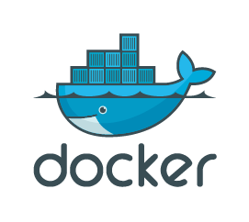
System Architecture
Frontend
Backend
Docker Container
Docker Container
Virtual Machine
Amazon Web Services

Slide 11
Software Architecture
Upload file (english language)
(PDF /PNG /JPEG)
Send file to backend
POST /file/upload
Upload file to S3 bucket
Check if audio file is created
Download
audio file
GET /file/find
Get audio file
GET /file/download
Download audio file
Publish execution logs
Convert translated text for each language into audio file
Translate extracted text (English) into Hindi and Chinese
Trigger:
Pick up the latest uploaded file
Extract text from input file
cc-documents-bucket
Insert data into Logs table
cc-audio-bucket
Extract audio response and store audio files for all three languages (English, Hindi and Chinese)

Slide 12
Backend
Language | Java 11
Web framework | Spring Boot
AWS library | AWS SDK for Java
Build Automation tool | Gradle (Groovy)
API documentation | Swagger 2
Version control system | Git, GitHub
Linter | Sonarlint

Slide 13
Frontend
JavaScript library | React
CSS framework | React-Bootstrap
Web technologies | HTML5 (Audio), CSS
HTTP client | Axios
Version control system | Git, GitHub
Linter | Sonarlint

Slide 14
AWS Lambda
Language | Python 3.7
AWS SDK | boto3
Clients | S3 Textract Translate Polly DynamoDB

Slide 15

Containerization
Docker containers are a platform as a service product that use OS-level virtualization which is used to run software in packages called containers
Why are we using Docker?
Fast, consistent delivery of applications
Running more workloads on the same hardware

Slide 16
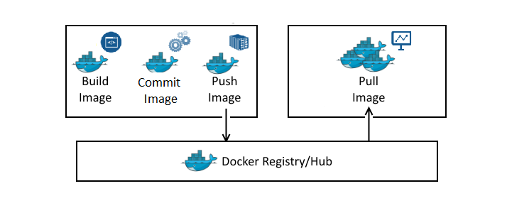
How to containerize
Two containers (one for client and another for the server) on two EC2 instances enabling rapid deployment
Container 1: React Frontend
Container 2: Java Backend
Steps to create our containers:
Create Dockerfile
Build the container image:
sudo docker build .
Provide a tag:
sudo docker tag <id> <dockerhubID>/<repo>:<tag>
Push image to dockerhub to access it on EC2 instance:
sudo docker push <dockerhubID>/<repo>:<tag>
Run the image on EC2 instance after pulling it from dockerhub:
sudo docker run -d -p <host_port:container_port> <dockerhubID>/<repo>:<tag>

Slide 17
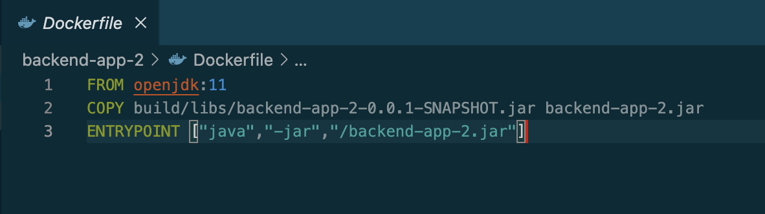
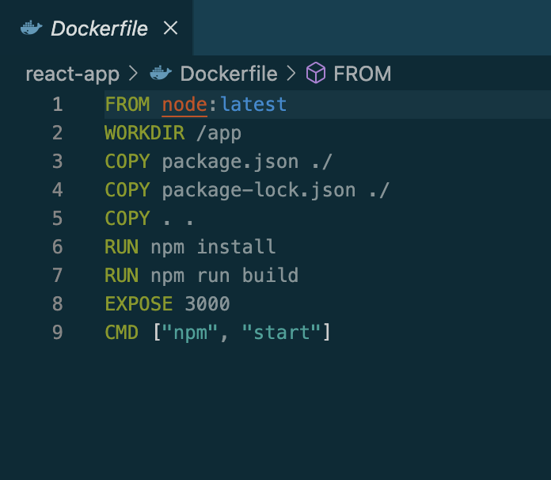
Dockerfile
Backend
Frontend

Slide 18
Deployment
For deployment, AWS EC2 was used
EC2 is secure and resizable compute capacity for virtually any workload
> 500 instances and choice of the latest processor, storage, networking, operating system, and purchase model to help you best match the needs of your workload.
Supports Intel, AMD, and Arm processors, as well as EC2 macOS instances

Slide 19
EC2 Use Cases
Provides compute infrastructure to run cloud-native and enterprise applications
Scale for high performance applications
Train and deploy ML models and applications
deploy websites and backend applications*

Slide 20
Load Balancing
To efficiently distribute traffic a load balancer was used
AWS provides Elastic Load Balancing (ELB)
Automatically distributes incoming application traffic across multiple targets and virtual appliances in one or more Availability Zones (AZs)
Use Cases of Load Balancing:
Modernize applications with serverless and containers
Improve hybrid cloud network scalability
Retain your existing network appliances

Slide 21
Types of load balancer
Application load balancer
Gateway load balancer
Network load balancer

Slide 22
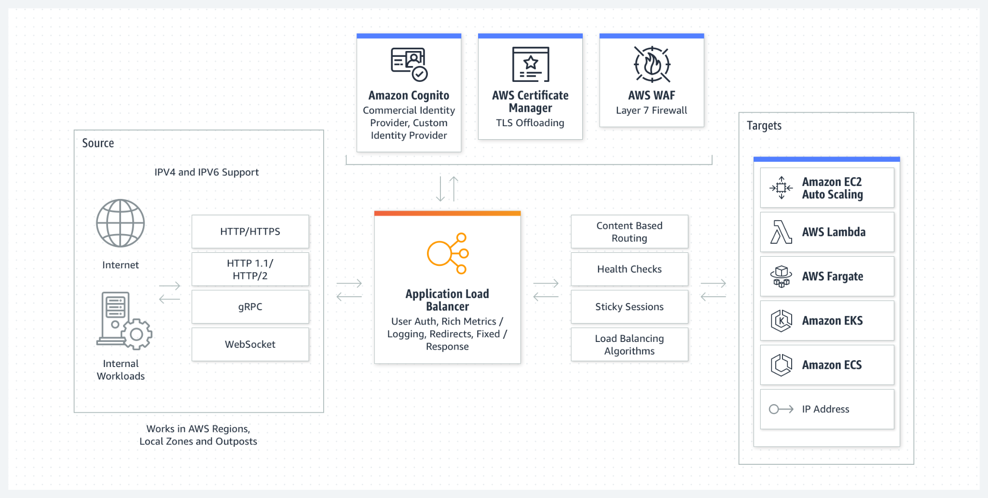
Application Load Balancer
Components of load balancer:
Load balancer
Listener
Target group

Slide 23
Improvements & Possible Future Work
User authentication functionalities
Convert React code to package it as npm package
To support all languages provided by AWS Translate
CI/CD pipeline
Cloud orchestration using Terraform
Take input in other languages

Slide 24
Task Division
Ruchi
Designed high-level and low-level design for both frontend and backend
Developed both frontend and backend
Developed AWS Lambda to integrate with other AWS services
Kunal
Built JAR files using gradle for springboot backend
Built React production file using npm build
Containerized the frontend and backend
Pushed containers to Dockerhub
Sanfer
Set-up EC2 instances and deployed frontend (React) and backend(SpringBoot)
Set up security groups for incoming traffic
Tested routes using public IP of instances
Stuti
Created target groups for efficient routing
Designed Load balancer
Added java health check route functionality to check networking

Slide 25
Demo!

